Slide 1

Gateway Mobile Location Centre GMLC
Supervisor
Mr. Georges Yazbeck
Presented by
Elie Rahal
Victoria Tebchrany Manuel Richa

Slide 2
Contents
1
Objective
2
GSM Architecture
3
GMLC
GMLC Architecture
1
GMLC Request Flow
GMLC Configuration
4
Simulation

Slide 3
1 – Objective

Slide 4

Problem
GSM
Architecture
GMLC
Simulation
GSM subscriber’s location needed

Slide 5




Problem
GSM
Architecture
GMLC
Simulation
Functional GSM units interact to get the location
Complex GMSC interface (TCP)

Slide 6




Problem
GSM
Architecture
GMLC
Simulation
Functional GSM units interact to get the location
Complex and Unsecure GMSC interface (TCP)
Solution: GMLC
GMLC

Slide 7
2 – GSM Architecture

Slide 8
Problem
GSM Architecture
GMLC
Simulation
Smallest Area: Cell
N Cells = Location Area

Slide 9

Problem
GSM Architecture
GMLC
Simulation
N Location Areas = MSC/VLR Service Area

Slide 10

Problem
GSM Architecture
GMLC
Simulation
N MSC/VLR Service Area = PLMN
MSC/VLR
MSC/VLR
MSC/VLR
MSC/VLR
MSC/VLR
MSC/VLR
MSC/VLR
MSC/VLR
MSC/VLR

Slide 11


Problem
GSM Architecture
GMLC
Simulation
N MSC/VLR Service Area = PLMN
HLR contains subscriber information

Slide 12


Problem
GSM Architecture
GMLC
Simulation
GMSC receives location request
GMSC interrogates the HLR
HLR delegates request to VLR
PLMN
MSC/VLR Service Area

Slide 13
Problem
GSM Architecture
GMLC
Simulation
SS7 Signaling System
GSM units(HLR/VLR) communicate using MAP layer messages
MAP
DTAP | BSSAP |  | ISUP |  | TUP
 |  | TCAP
SCCP
MTP 3
MTP 2
MTP 1

Slide 14



Problem
GSM Architecture
GMLC
Simulation
GMLC interfaces
Client
Client
HLR
MSC/VLR
GMSC
GMSC
GMLC
GMLC
HTTP
TCP
Client
GMSC
GMLC

Slide 15
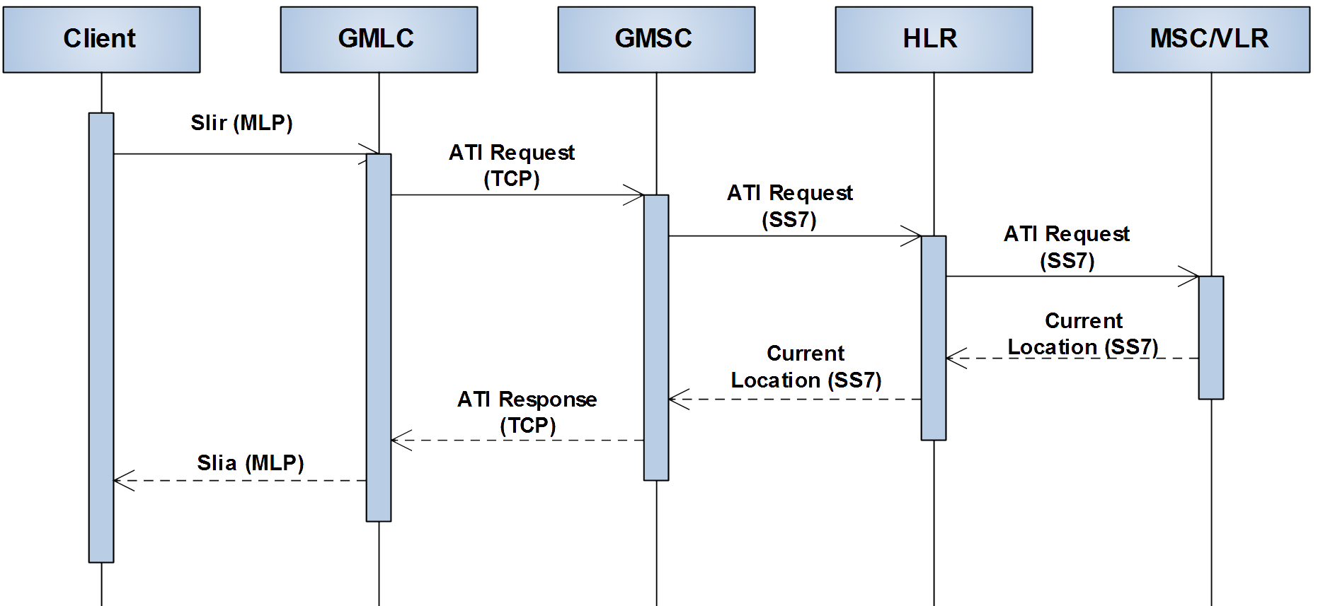
Problem
GSM Architecture
GMLC
Simulation
Client
HLR
MSC/VLR
GMSC
GMLC
Two request possibilities :
ATI: AnyTime Interrogation → Location
SRI: Send Routing Info → Network Routing

Slide 16
3 – Gateway Mobile Location Centre
GMLC

Slide 17
Problem
GSM Architecture
GMLC
Simulation
GMLC Architecture
GMLC Request Flow
GMLC Configuration

Slide 18
Problem
GSM Architecture
GMLC
Simulation
GMLC Architecture
GMLC Request Flow
GMLC Configuration

Slide 19
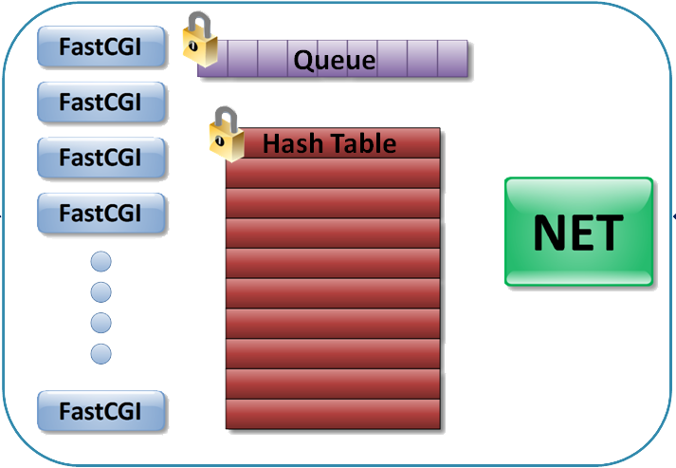
Problem
GSM Architecture
GMLC
Simulation

Slide 20
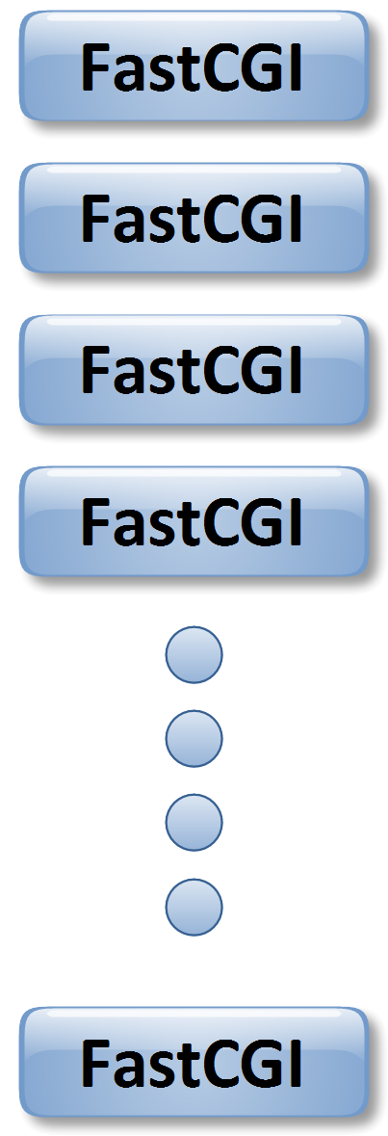


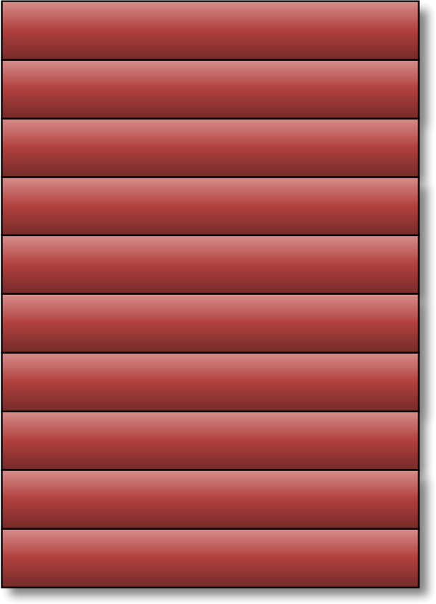

Problem
GSM Architecture
GMLC
Simulation
GMLC Architecture
Queue
Hash Table
HTTP
TCP

Slide 21



Problem
GSM Architecture
GMLC
Simulation
FastCGI
1 HTTP Req
FastCGI → HTTP interface with clients
FastCGI hosted by Apache HTTP Server
Apache server configured to spawn n FastCGI processes
Each FastCGI → 1 HTTP Request
Apache Server adds authentication and encryption
1 HTTP Req
1 HTTP Req
1 HTTP Req
1 HTTP Req

Slide 22
Problem
GSM Architecture
GMLC
Simulation
NET
Queue
Hash Table
Connects to GMSC [1..*]
Under TCP
HTTP
TCP

Slide 23


Problem
GSM Architecture
GMLC
Simulation
Hash Table
Shared Memory
Data link between NET – FastCGI
Synchronized
Queue
Hash Table
HTTP
TCP

Slide 24
Problem
GSM Architecture
GMLC
Simulation
Queue
Queue
Queue passes signals from FastCGI to NET
Synchronized
Hash Table
HTTP
TCP

Slide 25


Problem
GSM Architecture
GMLC
Simulation
memcached
FastCGI caches results

Slide 26
Problem
GSM Architecture
GMLC
Simulation
GMLC Architecture
GMLC Request Flow
GMLC Configuration

Slide 27
Problem
GSM Architecture
GMLC
Simulation
Queue
Hash Table

Slide 28








Problem
GSM Architecture
GMLC
Simulation
<slir rtype='ati'>
<ati>96271234567</ati>
<sri>96271234567</sri>
</slir>
SLIR
Request Data
Apache Server spawns the FastCGI processes
FastCGI initializes Hash Table and Queue
Client Sends SLIR request - FastCGI Reads and Parses XML
FastCGI checks if response in cache
PID hashed to Get the position in Hash Table
FastCGI inserts position in Queue and data in Hash Table

Slide 29










Problem
GSM Architecture
GMLC
Simulation
SLIR
Request Data
SLIR
Request Data
Checking
for response…

Slide 30

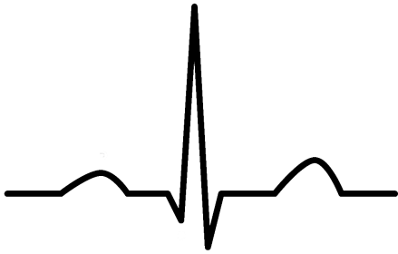



Problem
GSM Architecture
GMLC
Simulation
Request Data
Request Data
NET iterates over Hash Table, Queue and GMSC
Heart Beat → checks the status of the GMSC connection
NET reads a position from queue
NET fetches the corresponding hash record
NET forms the packet and sends it into the GMSC

Slide 31

Problem
GSM Architecture
GMLC
Simulation
Request Data
Request Data

Slide 32



Problem
GSM Architecture
GMLC
Simulation
Response Ready
Request Data
Request Data
Request Failed
Packet Type = Heart Beat Signal → send Acknowledgment
Packet Type = Correct ATI response → Fill correct result in hash table
Packet Type = Erroneous ATI response → Fail corresponding record

Slide 33
Problem
GSM Architecture
GMLC
Simulation
SLIR
Response Ready
Request Data
SLIR
Request Data
Request Failed
Checking
for response…
Response ready in Hash Table, each FCGI takes its response

Slide 34
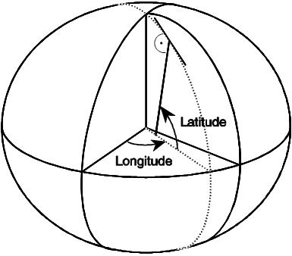

Problem
GSM Architecture
GMLC
Simulation
<slia>
<AgeOfLocation>0</AgeOfLocation>
<GeographicalInfo>
<EllipsoidPoint>0</EllipsoidPoint>
<DegOfLatitude>80.000000</DegOfLatitude>
<DegOfLongitude>45.000000</DegOfLongitude>
<UncertainityCode>1</UncertainityCode>
</GeographicalInfo>
<VlrNumber>
<NatureOfAddress>1</NatureOfAddress>
<NumberingPlan>1</NumberingPlan>
<Address>96271234567</Address>
</VlrNumber>
<LocationNumber>
<NatureOfAddress>1</NatureOfAddress>
<NumberingPlan>10</NumberingPlan>
<Address></Address>
</LocationNumber>
<GCellID>
<mcc>41610</mcc>
<mnc>10</mnc>
<lac>221</lac>
<cellId>1047</cellId>
</GCellID>
<SubscriberState>0</SubscriberState>
<NotReachableReason>0</NotReachableReason>
</slia>
Fail
Response Ready
SLIA
Request Failed
FastCGI caches a copy of the correct ATI response

Slide 35
Problem
GSM Architecture
GMLC
Simulation
SLIA
SLIR
Response found in cache no need to go to the network
Same request is received

Slide 36
Problem
GSM Architecture
GMLC
Simulation
GMLC Architecture
GMLC Request Flow
GMLC Configuration

Slide 37
Problem
GSM Architecture
GMLC
Simulation
Configuration File
[gmlc]
ProgName=gmlc
JQueueFile=/home/ul2010/GMLC_Files/gmlcQueue
JQueueSemKey=2525
NBQueueRecords=1009
RequestType=1
CleanTimer=60
RecordTimeOut=30
[net]
ProgName=netHash
LogFileName=/home/ul2010/log/netHash
DebugLevel=5
noGmsc=2
gmsc_port1=8003
gmsc_ip_address1=192.168.49.94
gmsc_port2=8003
gmsc_ip_address2=192.168.49.132
gt=962798000137
ReadTimeOut=100
noRequestPerLoop=50

Slide 38
Problem
GSM Architecture
GMLC
Simulation
Configuration File - continued
[hash]
primary_list_size=1009
overflow_list_size=400
record_list_filename=/home/ul2010/GMLC_Files/hashListFile
HashSemKey=887
[gmlcFcgi]
ProgName=gmlcFcgi
LogFileName=/home/ul2010/log/gmlcFcgi
DebugLevel=5
SleepTimeBetweenCheck=1
MemcacheTimeOut=1
RequestTimeOut=20
MemcachedHost=florida
MemcachedPort=11211

Slide 39
4 - Testing

Slide 40
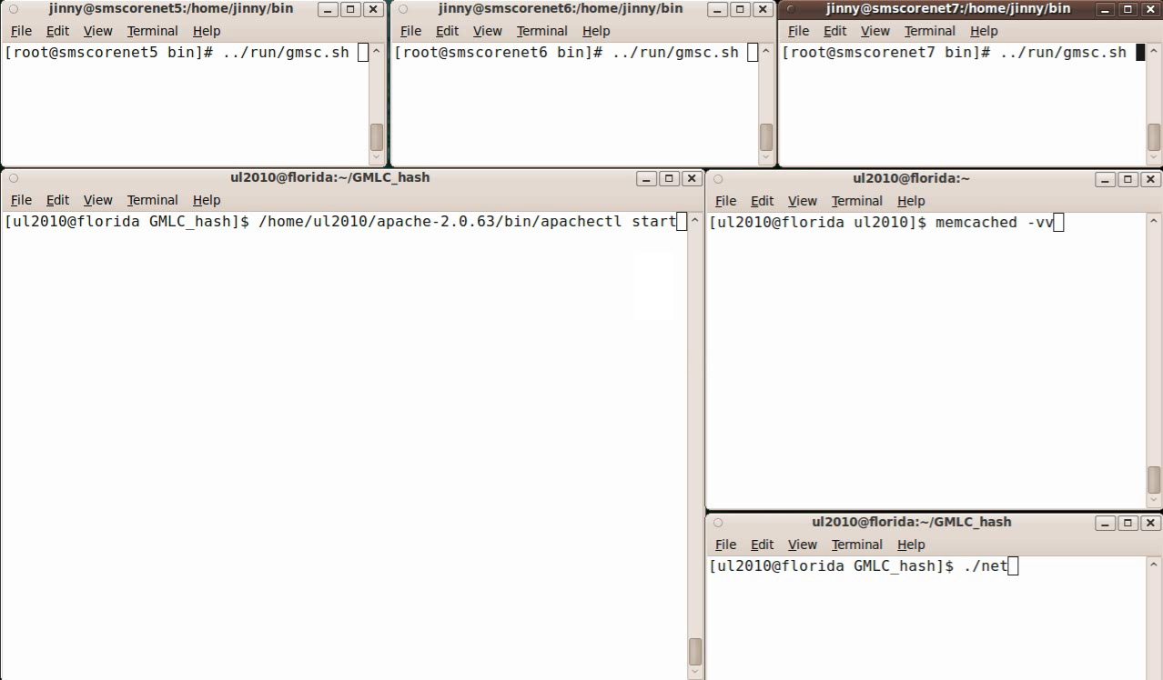
Problem
GSM Architecture
GMLC
Simulation

Slide 41
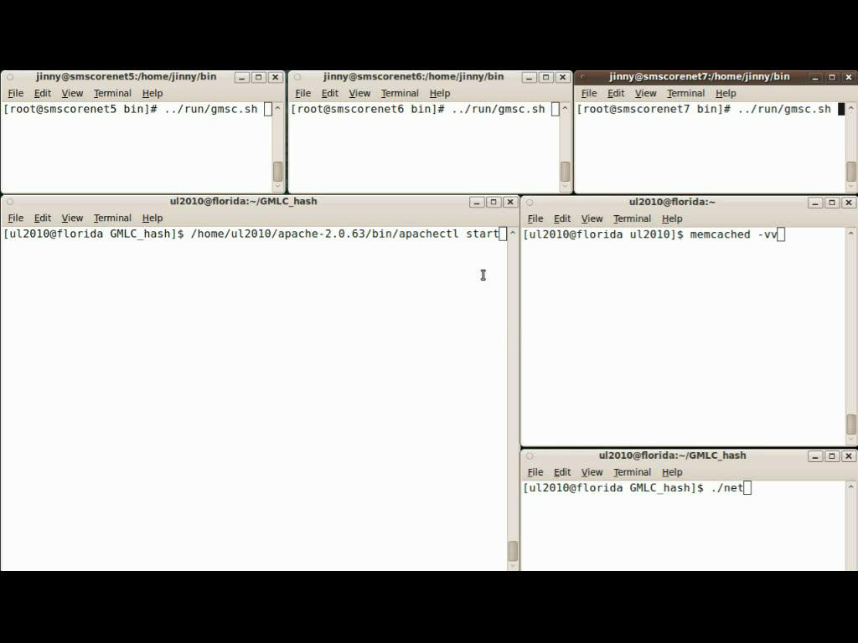
Problem
GSM Architecture
GMLC
Simulation

Slide 42
Thank You

Slide 43
Questions?

